Slide 1
Computer Vision
Transfer Learning

Slide 2
Biggest trick in computer vision and deep learning!

Slide 3
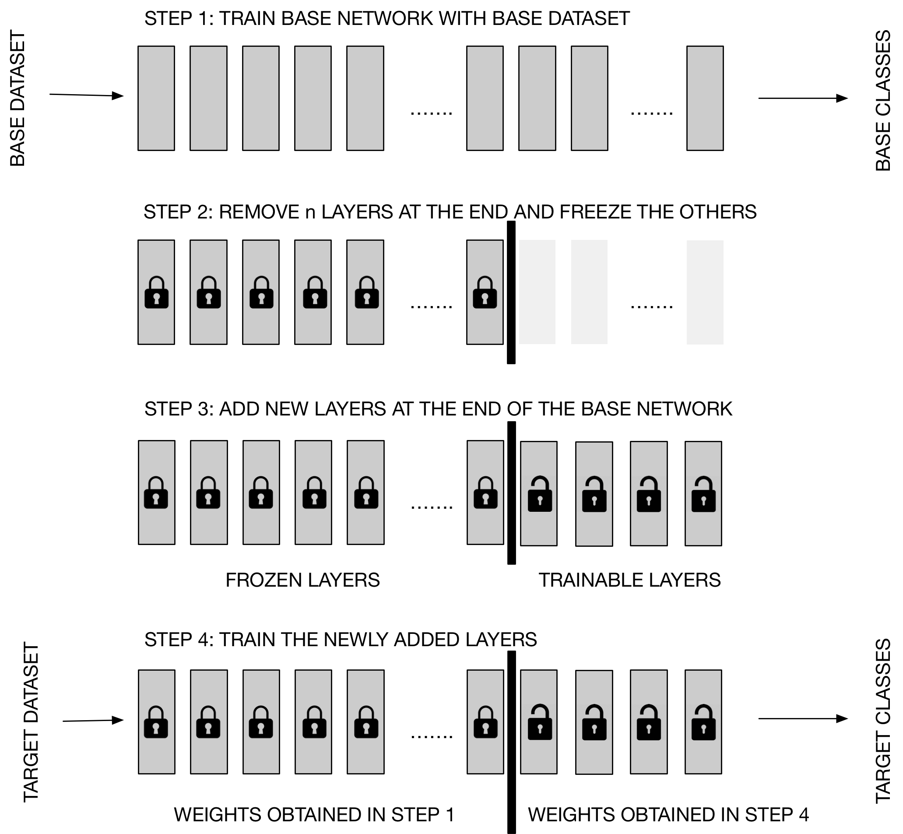
Transfer Learning
Step 1
Step 2
Step 3
In this approach, the entire network has to be trained several times (to tune the hyperparameters). This can be slow.
Step 4
Quelle: Michelucci, U. (2019). Advanced applied deep learning: convolutional neural networks and object detection. Apress.

Slide 4
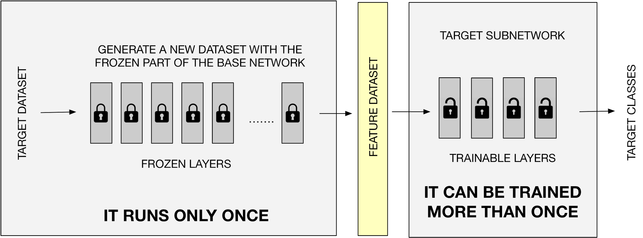
We can make transfer learning more efficient.
Quelle: Michelucci, U. (2019). Advanced applied deep learning: convolutional neural networks and object detection. Apress.

Slide 5
A few numbers (how to become more efficient)
Approach 1 (Naïve)
Approach 2 (Smart)
1 EPOCH 🡪 4.5 minutes
1 EPOCH 🡪 6 seconds
100 EPOCH 🡪 7.5 hours
100 EPOCH 🡪 10 minutes
The numbers come from a test with a "dog/cat" image dataset of about 800 MB. All information can be found in Michelucci, U. (2019). Advanced applied deep learning: convolutional neural networks and object detection. Apress.

Slide 6
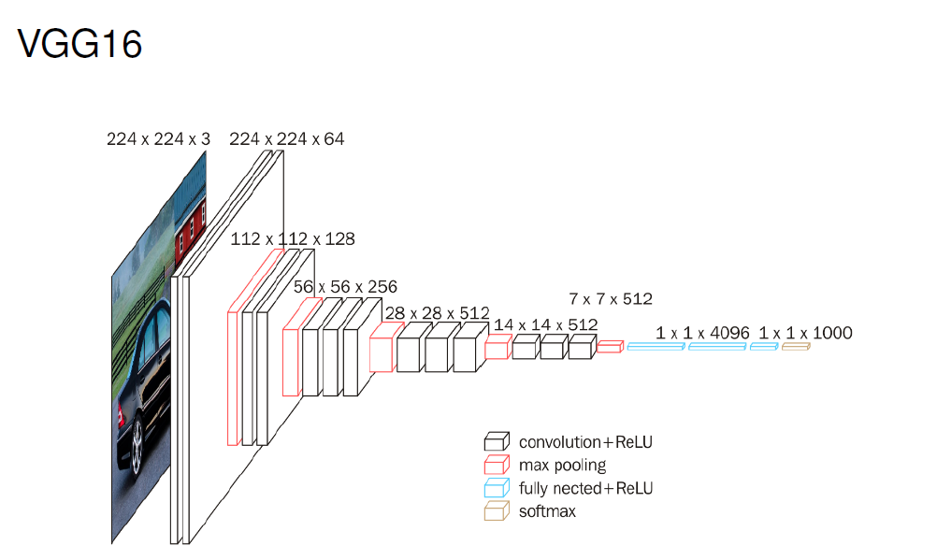
Original Paper: https://arxiv.org/pdf/1409.1556

Slide 7
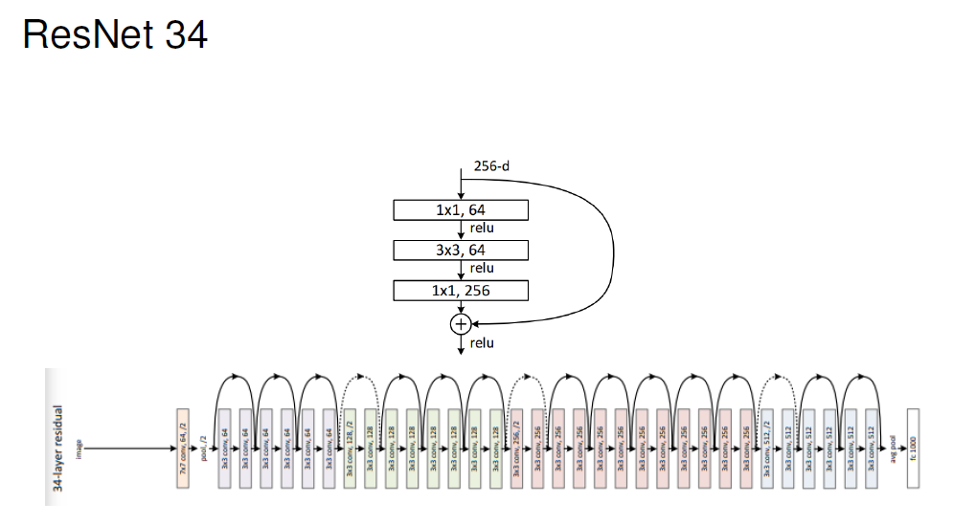
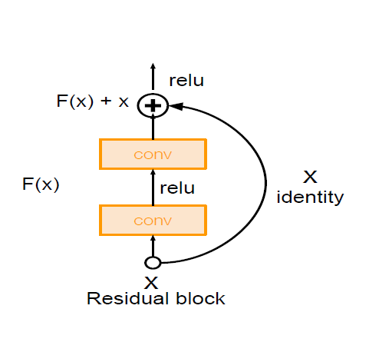
Original Paper: https://arxiv.org/abs/1512.03385
Notes:
A standard network layer tries to learn a direct mapping, let's call it H(x), from an input x. A residual block, however, reformulates this. Instead of learning H(x) directly, it learns a residual function, F(x), which is the difference between the desired output and the input.

Slide 8
Code Discussion
Transfer Learning

